Slide 1
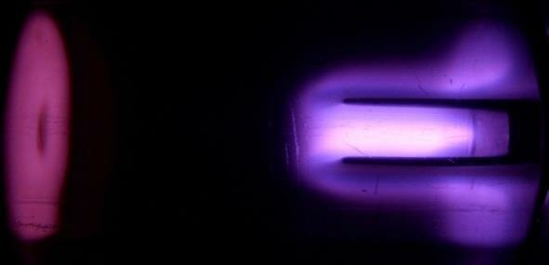

ION-I Scientific Visualization
Fall 2026 Kickoff

Slide 2


Research scope
Electric Propulsion Initiative - ION-I
Scientific visualization within Plasma Source
Extend particle visualization to engineering geometry and field data
Develop scientific figures for papers and technical reviews
This semester: Club homepage for research results and visualizations
Fall 2026
2

Slide 3
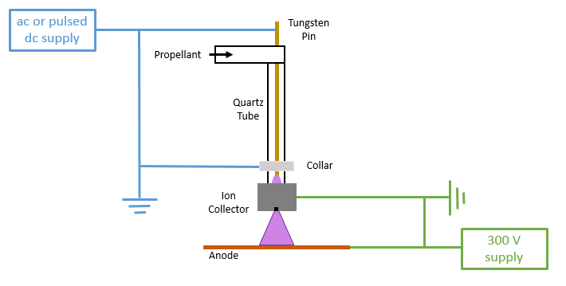
Plasma-source physics
Electric Propulsion Initiative - ION-I
Reference device: Gott & Xu’s microplasma cathode
Electron-emission models for the tungsten electrode
Electron-impact excitation and ionization of argon
Metastable argon and stepwise ionization pathways
Fall 2026
3

Slide 4
Technical foundation from last year
Electric Propulsion Initiative - ION-I
Emission physics | Fowler–Nordheim and Murphy–Good model prototypes
Argon kinetics | 0D rate equations for excitation and stepwise ionization
Data and rendering | Shared particle datasets, PyVista/VTK and Trame Getting Started — PyVista Tutorial Kitware/trame
Fall 2026
4

Slide 5
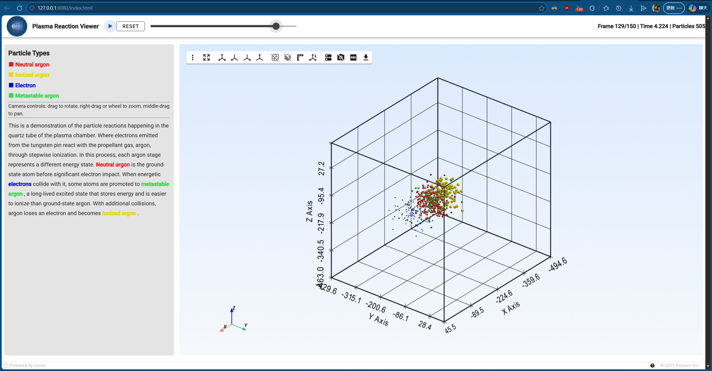
Particle-state visualization
Electric Propulsion Initiative - ION-I
505 tracked particle IDs across 150 frames
Neutral Ar, metastable Ar, ions and electrons
Fall 2026
5

Slide 6
Research value
Electric Propulsion Initiative - ION-I
Research publications | Create scientific figures and renderings for papers and publications
Model inspection | Inspect geometry, particle states and simulation outputs in 3D
Reproducible figures | Record source data, model assumptions and rendering settings
Fall 2026
6

Slide 7
This semester’s main project
Electric Propulsion Initiative - ION-I
Club homepage
Publish ION-I’s research projects, methods and technical results
Present scientific figures with interactive views of the underlying data
Fall 2026
7

Slide 8
Planned website content
Electric Propulsion Initiative - ION-I
Homepage | Thruster architecture, research objectives and project status
Subteam research | Hardware, models and analysis from each engineering team
Scientific gallery | CAD assemblies, cutaway renders and interactive data views
Technical record | Methods, references and links to source data and code
Fall 2026
8

Slide 9
Proposed research workflow
Electric Propulsion Initiative - ION-I
1 Data and geometry | Review source data and prepare geometry for visualization
2 Homepage | Publish the club overview and technical project pages
3 CAD and figures | Build a simplified cathode assembly and cutaway renders
4 Integration | Connect the viewer and publish documented figure examples
Target: Club homepage, a plasma viewer and a reproducible figure workflow
Fall 2026
9

Slide 10
Cross-team research directions
Electric Propulsion Initiative - ION-I
Discharge Chamber
Ion Optics
Early scope: chamber and magnet geometry
With analysis data: magnetic-field maps and profiles
Early scope: grid geometry and aperture alignment
With analysis data: potential contours and ion trajectories
Fall 2026
10

Slide 11
Technical work areas
Electric Propulsion Initiative - ION-I
Research website | Technical project pages and integration of interactive views
CAD and rendering | Component modeling, assembly views and scientific figure export
Physics and data | Model assumptions, data provenance and interpretation
Fall 2026
11

